Slide 1
Business Model for Public Colleges and Universities October 27, 2016

Slide 2
Agenda
Diagnostics
Situational Assessment in Higher Education
Situational Assessment of Your Institution
Exploration
Macro Trends Shaping Higher Education
Building Blocks for Revenue Growth and Diversification
Implementation
Operational Execution
Prosperous Future

Slide 3
Mission Statement
AGB Institutional Strategies integrates institutional outcomes, market trends, and data-guided decision making to ensure financial prosperity.

Slide 4
Business Model Challenges
The changing competitive landscape presents a serious challenge for colleges and universities across the country
Institutions are struggling to match revenues with expenditures, while simultaneously trying to cope with:
Lower net revenue per student
Rising costs
Evolving consumer behaviors
Digital technology
Shifting student demographics
As a result, institutions are forced to address their business models
Institutional willingness and resolve will be greatly tested

Slide 5
Situational Assessment of Higher Education

Slide 6
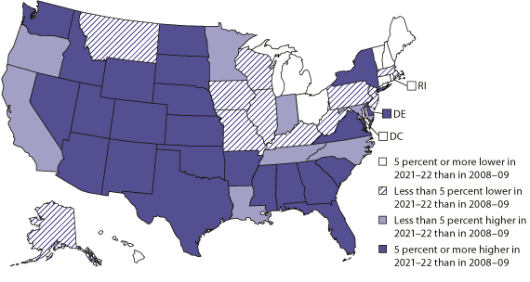
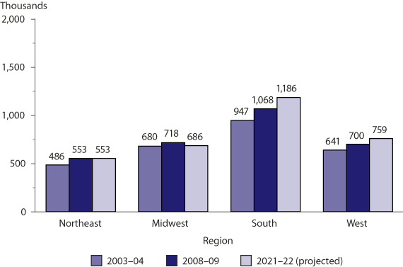
Demographic Shifts

Slide 7
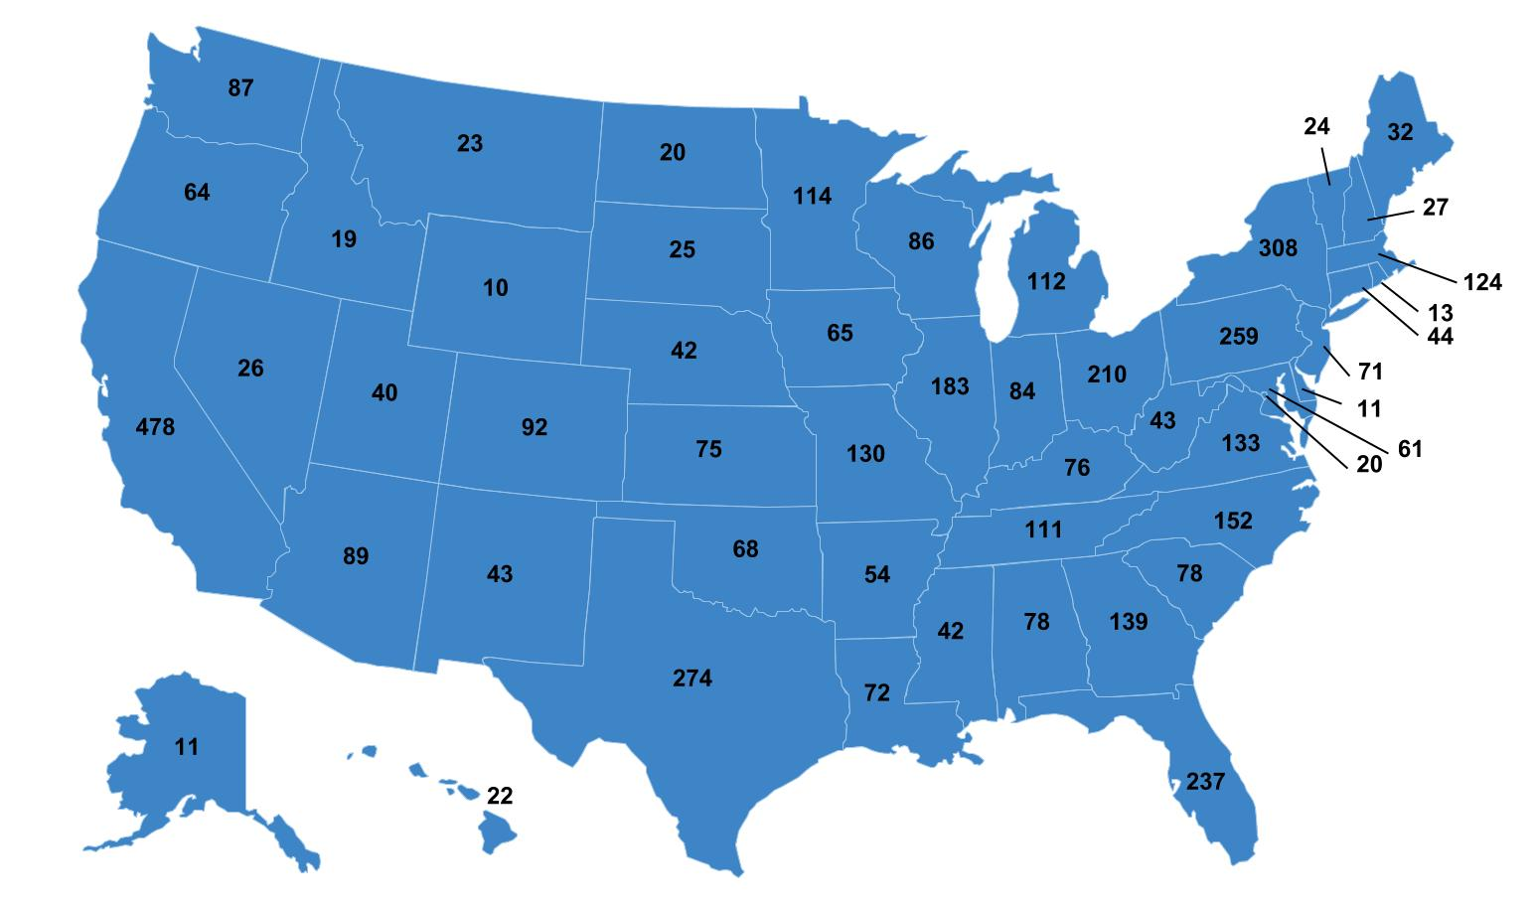
Number of Institutions
The Chronicle of Higher Education Almanac, 2016

Slide 8
Expected Enrollment Growth Rate

Slide 9
Readiness Trend
ACT, 2016

Slide 10
Technology Migration
More than 7.1 million students, 33 percent of total higher education enrollment, have taken at least one online class
In 2014, there were 3.4 million college students engaged in fully online programs
Now larger than the traditional campus delivery model
Technology will play a growing role in the delivery methodology.
Digital delivery, interactive video, mobile learning
Beyond the demographic shift, students are migrating towards technology for convenience

Slide 11
State Appropriations
State appropriations have been in decline for 23 states, since the recession of 2007-2008
All 50 states have reduce spending. 48 states are spending less per student than they did before the recession of 2007-2008.
The average state is spending $2,026, 23% less per student than before the recession
These appropriation cuts have resulted in a 28 percent rise in tuition prices at state institutions across the country

Slide 12
Lower Net Tuition per Student
The average tuition price published at four-year private colleges is $32,405
The average freshman discount in 2014 was 48% (new students)
Net tuition revenue of $14,809
Some private colleges have discount rates as high as 65%
Illinois In-State is $13,000 – 4 Year
Illinois In-State is $4,000 – 2 Year
U.S. average in-state tuition for public institutions is $9,410
Public institutions are now starting to discount or offer out-of-state students in-state tuition
Median household income for the United States was $56,516 in 2015 – discounting pressures will continue (2009 - $56,731)
Illinois average income is $59,588

Slide 13
Changing Consumer Behaviors
Consumers are becoming more judicious with their college selection
Price and value are critically important
In the eyes of the consumer, student loans are no longer considered “financial aid”
For consumers, lower cost of education means lower tuition prices
Institutions are cutting costs, which is required for survival, but cut costs do not necessarily translate to lower consumer price

Slide 14
Cost Cutting
Across the country, institutions are reshaping their business models starting with cost cutting
Consolidation of institutions with a single administration
CT proposal, stating that tenured faculty members may be assigned involuntarily to another campus, without the guarantee of continued tenure
Faculty layoffs in the absence of financial exigency, including tenure track
Deep cost cuts across the board
Program cuts
Pay cuts, elimination of 403(b) contributions

Slide 15
Alignment of Costs
and Revenue
Cost containment is critical for a successful long-term financial model
Short-sighted cost cuts can also have negative consequences
Across the board cuts, hurt great programs and reward weak programs
Good people leave the organization
Service diminishes
Revenue erodes

Slide 16
Sustainable Business Models
Revenue growth and diversification approaches have not been part of higher education’s typical response to budget challenges
Growing and diversifying revenue is more difficult than cutting expenses, and requires an element of operational execution that may challenge the capabilities of the institution

Slide 17
Campus Based Model
Market demand for traditional campus based delivery is shrinking
Negative trends working against the traditional model
Geographic shifts
Consumer behaviors – cost issues
Digital technology – convenient and lower cost
New alternatives becoming available for traditional students – certificates, badges, corporate training
In five years will these trends reverse?

Slide 18
Situational Assessment of Your Institution

Slide 19
High Innovation and Creativity
Strengthen competitive position
market-share gains
leverage strengths
new revenue sources
Revenue diversification
New programs
blended delivery
Service, speed, statistics
Macro trend revenue
Productivity
Lowering costs
High
Low
Innovation and Creativity Requirement
Make slight operating adjustments
Cost cutting
(traditional approach)
is not enough to create a long-term sustainable business model
Low High
Financial Challenge

Slide 20
Quantifying Financial Challenges
As part of a diagnostics review, institutions must quantify their situation and gain consensus among key constituents
Financial Gaps
Existing gap in financial performance due to service, debt, and fund depreciation
Cash flow or losses from operations
Operational Gaps
Student services and support
Academic support
Marketing and student acquisition
Program development (R&D)
People – salaries
Infrastructure Gaps
Deferred maintenance – funding depreciation
Technology requirements
Facility needs

Slide 21
Exploration Macro Trends Shaping Higher Education

Slide 22
The Exploration Process
The exploration process fosters creativity and innovation to develop alternative strategies for a sustainable business model
As part of the exploration process, institutions are encouraged to “find themselves” within the macro trends
Alignment of the macro trends with institutional strength, mission, and needs (quantified in the discovery process) sets the vision for prosperity

Slide 23
Macro Trends Setting Context
Macro Trends
Setting Context
macro trends shaping higher education
Transfer students
IBM Ceo study on skillsets
Association of American colleges and Universities Expectation gaps
Job related Curriculum
Growth Areas
Speed, Service and Statistics

Slide 24
Unbundling and Transfer Students
Unbundling the Degree
Transfer Students – 75%
The trend of unbundling classes and credits from the institution’s core has already begun
Similar to purchasing individual songs (94%) vs. albums (6%)
Allows students to obtain college credits from many sources; the world will become the classroom
There is an explosion of education content, allowing students to more easily obtain credits for transfer towards their degree
75% of students will attend two or more colleges prior to graduation

Slide 25
Transfer Students
Transfer students represent a major opportunity for growth and diversification
Requires speed and service to maximize competitiveness
Many old paradigms around serving and processing transfer students (tactical)
Transfer students are of all ages
Transfer student entry class should be as large as your freshman class – great diversification opportunity

Slide 26
Comparing Market Segments
The available market for adult degree completion is larger than the traditional high school segment
40 million adults with college credit and no degree
National market
Necessitates speed and service
3.3 million high school students graduating annually
Local and regional market
Demographic shift
Changing consumer buying habits

Slide 27
Online Programming
A decade ago, the concept of online learning was new to higher education. Today, more than 1,000 colleges have some form of online programming.
Why do some institutions flourish with online programming, while others flounder? And what of the third group, that sits on the sidelines?

Slide 28
Expectation Gap
Expectation Gap
Students Parents Employers Colleges

Slide 29

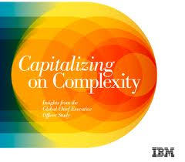


Expectation Gap
What External Constituents are Saying
IBM GLOBAL CEO STUDY
Insights from 1,500 CEOs and
3,600 Students in 60 Countries
Forbes on Education
“No field operates more inefficiently than education.
A new breed of disruptors is finally going to fix it.”
1,500 CEO’s on Education
“#1 CEO challenge is hyper- complexity. Higher Ed is not equipping graduates with the right mindset or skills.”
McKinsey on Education
“Students don’t believe traditional education drives job skills. Bottom line. Skills matter. Hard to get them.”

Slide 30
Liberal Arts Brand Gap
Negative Perception
Positive Reality
Perception that liberal arts does not prepare students for a job
Today, the brand – Liberal Arts is not synonymous with jobs and careers
Liberal arts will help prepare you for a job that does not exist, in an industry that has yet to be invented
Liberal arts will keep you on the inside of a job and career because of your ability to think, collaborate, solve complex problems

Slide 31
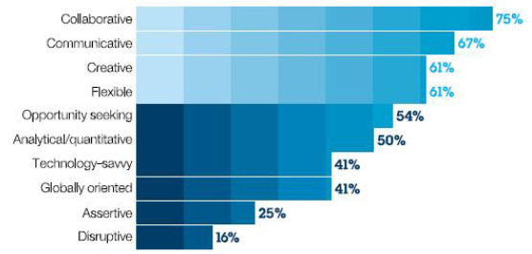








Survey of 1,500 global CEO’s
IBM GLOBAL CEO STUDY
Insights from 1,500 CEOs and
3,600 Students in 60 Countries
Top Ten Global Skills Needed
2012-13 - IBM CEO Study
Collaborative
Communicative
Creative
Flexible
Systems Thinking
Critical Thinking
Technology-savvy
Globally-oriented
Customer-oriented
Disruptive

Slide 32
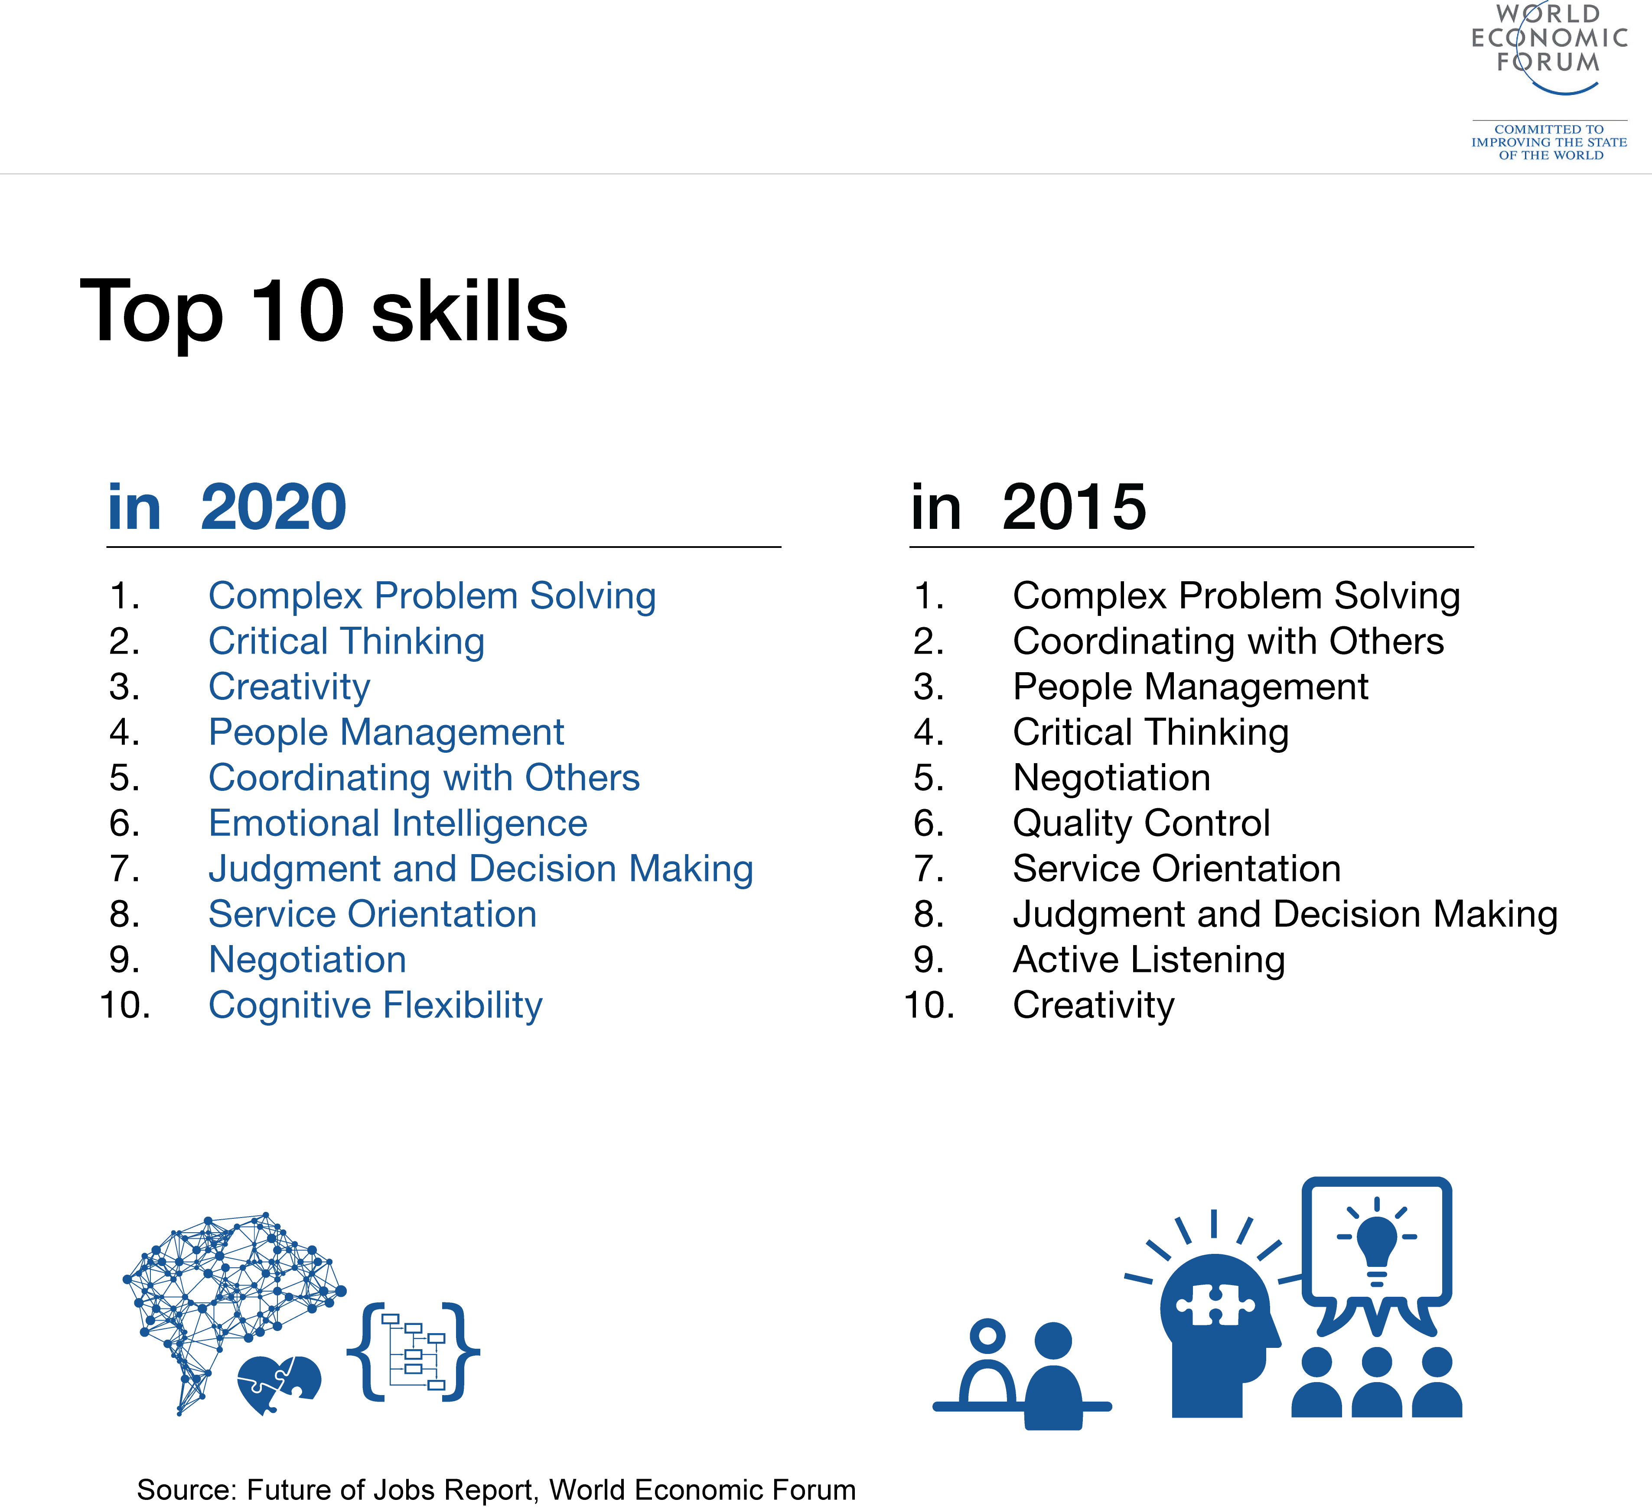
Given the abundance of liberal arts institutions, why do many industry leaders and other employers continue to complain about a “skills gap?”

Slide 33
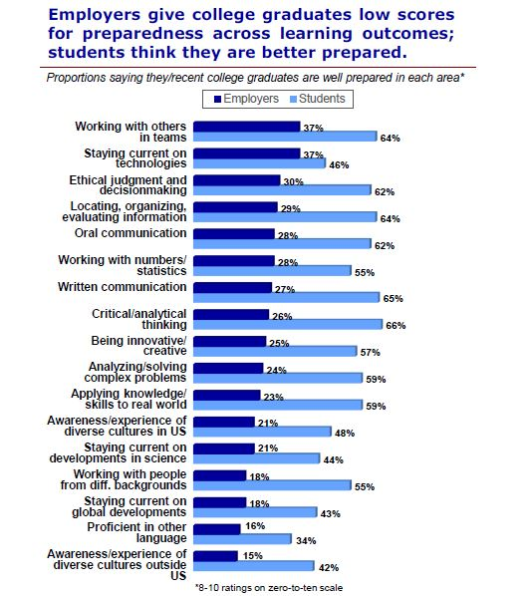
AACU Report 2015
The Association of American Colleges and Universities (AACU) asked groups of employers and college students a series of similar questions about career preparation.
2015 Report: Inside Higher Education, January 20, 2015

Slide 34
Student Expectations
Jobs – Why students attend college
Consumers are trending towards certifications and credentials as a means towards job creation
Bypassing college to focus on jobs
Reduces the available student market
Cost – Student debt is now at the consciousness level of consumers
$1.6 trillion of student debt
Average debt $29,400 (requires $440 per month of gross income over ten years)

Slide 35
Speed, Service, and Statistics
Adult and Transfer Students
High School Matriculation
Requires speed, service, and convenience
Processing speed measured in seconds, minutes, hours, days
Multiple enrollment start times
Instant start times
Colleges that rely upon a traditional selling rhythm are able to get “some students”
Institutions that have separate selling methodologies take the vast majority of market share and have significant growth
Single entry point for recent high school graduates
Establishes a rhythm that is slow and predictable
Days, weeks, months, years
Travel season, campus visits, acceptances, FAFSA, financial packaging, deposits
Slower rhythm compared to requirements of adult and transfer students

Slide 36
Speed with
Financial Packaging
New FAFSA change will allow faster packaging – window of opportunity to take market from institutions that do not become proactive

Slide 37
Building Blocks for Growth and Diversification

Slide 38
Focus on Prosperity
Situational assessment for your own institution (Diagnostics)
Which includes the financial quantification
Collaboration and consensus on the diagnostic assessment
Macro trends shaping higher education (Exploration)
Alignment of mission and strengths
Creativity and innovation will be required, along with institutional resolve
Developing growth building blocks
Develop tactical execution plans (Implementation)
Key assumptions, internal obstacles, leadership accountability, required measurement metrics, financial modeling, risks, investments, milestones, and timelines

Slide 39
Campus Based Enrollment
Doing the same thing will get you the same results
Doing something marginally better, will get you marginally better results
Speed and service are two attributes that can contribute to a major change in results
There will be challenges to changing the internal operational rhythms
“We have always done it this way”
Many self inflicted wounds which prevent success
Service sells and often be the #1 consideration for students and families; when experienced, they will respond
How institutions respond to: applications, financial aid, follow up, academic advising, transcript processing, measuring speed of response
Retention of students is worth an investment
But only if an institution is willing to approach the work differently
Proactive: Early academic success, coaching and mentoring is critical
Reactive: Early warning systems don’t work – they are slow and reactive

Slide 40
Trends and Challenges
Growth Trends
CHALLENGES
Transfer students
Adult degree completion
Hispanic market
Job skills based programs
Certifications
Digital delivery of academic content
Coaching and mentoring
Service and speed
Deflationary pricing and net price erosion
Demographics and alternative delivery methods will reduce market demand for campus based delivery
The big will get very big and take market share from small and mid-sized institutions
Institutional resolve will be more scarce than financial resources
Implementation and execution will challenge traditional operational rhythms of the institution
Continued cost cutting without revenue growth consideration results in a long slow path to irrelevancy

Slide 41
Building Blocks
for Growth
In collaboration with key thought leaders and constituents, identify three to six growth building blocks which align institutional mission and strengths to the macro trends shaping higher education
Collectively these building blocks should have enough growth potential to address the financial gap and needs assessment of your institution
Modeling and documenting is critical
Growth assumptions possibilities (over three to five years)
Resource requirements
Internal challenges
Leadership and accountability ownership
Investment requirement
Implementation and execution assumptions and risks
Key measurement metrics
Pro-forma modeling of net financial contribution expectation

Slide 42
Implementation
and Execution
Before you start:
Leadership is required; who will have accountability to lead each growth building block? Will there be exclusive focus or be combined with another job?
Institutional challenges must be addressed
Self inflicted wounds must be identified and addressed
Old policies which no longer meet the needs of the market
Remove the barriers
Set up for success vs failure by addressing challenges, open communication and focused leadership
Investment into growth building blocks should take place when there is a likelihood for success and key assumptions are thoroughly understood

Slide 43
Summary
Situational Assessment in Higher Education
Challenging times for all institutions
Competitive market is changing
Situational Assessment of Your Institution
Quantify your financial gap
Gain consensus on situational assessment
Macro Trends Shaping Higher Education
Find the positive trends which align to your institution
Be aware of the negative trends
Building Blocks for Revenue Growth and Diversification
Develop individuals growth building blocks which in aggregate exceed your institutional financial gap
Implementation and Operational Execution
Address internal challenges before investing
Focus and leadership will be necessary

Slide 44
Thank You
Notes:
JP

Slide 45
